Slide 1

Data Structures
Lecture 19: B-Trees

Slide 2

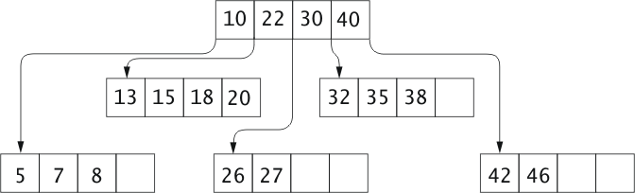
B-Trees
A B-tree extends idea behind 2-3 and 2-3-4 trees:
Allows a maximum of data items in each node
Order of a B-tree is maximum number of children for a node
B-trees developed for indexes to databases on disk
number of children: “5”

Slide 3
Motivation for B-Trees
Index structures for large datasets cannot be stored in main memory
Storing it on disk requires different approach to efficiency
Assuming that a disk spins at 3600 RPM, one revolution occurs in 1/60 of a second, or 16.7ms
Crudely speaking, one disk access takes about the same time as 200,000 instructions
Reference: http://cecs.wright.edu/~tkprasad/teaching.html

Slide 4
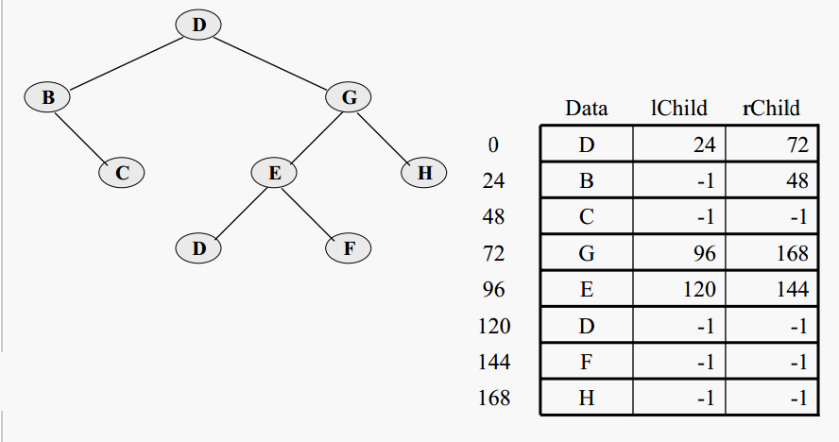

Storing Tree Date on a Disk
Storing a tree on a disk
-1
Refernece: http://courses.cs.vt.edu/cs2604/fall05/wmcquain/Notes/C12.B-Trees.pdf

Slide 5
Motivation for B-Trees (2)
Assume that we use an AVL tree to store about 20 million records
We end up with a very deep binary tree with lots of different disk accesses; log₂ 20,000,000 is about 24. Assuming each node is stored on a sector. The height of the tree is about 24. To find an item, we might need to navigate across 24 nodes to reach the target. so this takes about 24*(1/60) which is about 0.4 seconds.
We know we can’t improve on the log n lower bound on search for a binary tree
But, the solution is to use more branches and thus reduce the height of the tree!
As branching increases, depth decreases
Reference: http://cecs.wright.edu/~tkprasad/teaching.html

Slide 6
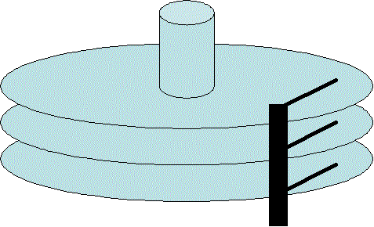
Disk Storage
  Disk storage is broken into blocks, and the time to access a block is significant compared to the time required to access data in internal memory.
  The nodes of a B-tree are sized to fit in a block, so each disk access to the index retrieves exactly one B-tree node.
http://www.dba-oracle.com/t_history_disk.htm

Slide 7
Analysis of B-Trees (1)
The maximum number of items in a B-tree of order m and height h:
  root m – 1
  level 1 m(m – 1)
  level 2 m²(m – 1)
  . . .
  level h m^{h}(m – 1)
So, the total number of items is
(1 + m + m² + m³ + … + m^{h})(m – 1) =
[(m^{h+1} – 1)/ (m – 1)] (m – 1) = m^{h+1} – 1
When m = 5 and h = 2 this gives 5³ – 1 = 124
Reference: http://cecs.wright.edu/~tkprasad/teaching.html

Slide 8
Analysis of B-Trees (2)
When searching tables held on disc, the cost of each disc transfer is high but doesn't depend much on the amount of data transferred, especially if consecutive items are transferred:
  If we use a B-tree of order 101, say, we can transfer each node in one disc read operation
  A B-tree of order 101 and height 3 can hold 101⁴ – 1 items (approximately 100 million) and any item can be accessed with 3 disc reads.
Reference: http://cecs.wright.edu/~tkprasad/teaching.html

Slide 9
Inserting an Item into a B Tree
Inserting “9”
Inserting “47”
Inserting “17”
22
10, 17
30, 40
10, 17, 22, 30, 40
10, 22, 30, 40
5, 7, 8
13, 15
18, 20
26, 27
13, 15, 17, 18, 20
5, 7, 8, 9
13, 15, 18, 20
32, 35, 38
42, 46, 47
42, 46

Slide 10
Removal from a B Tree (1)
We want to delete 2
12, 29, 52
If we delete an item from a leaf node, and that leaves the number of items greater than or equal to half the maximum size, then nothing should be done.
2, 7, 9
15, 22
31, 43
56, 69, 72
7, 9

Slide 11
Removal from a B Tree (2)
We want to delete 52
12, 29, 56
12, 29, 52
If we delete an item from an internal node(non-leaf node), we need to find a replacement for it. It is either the inorder predecessor or the inorder successor.
We chose the successor because it doesn’t leave the leaf node less than half full (unlike the predecessor).
15, 22
31, 43
69, 72
2, 7, 9
56, 69, 72

Slide 12
Removal from a B Tree (3)
We want to delete 22
12, __
12, 31
12, 29
If we delete an item from a leaf, and its size becomes less than half the size and one of its adjacent siblings has greater than half the size, we replace the item with either inorder predecessor/successor to eventually borrow an item from the adjacent sibling
31, 42, 56, 69
7, 9
15, 22
42, 56, 69
15, __
15, 29

Slide 13
Removal from a B Tree (4)
We want to delete 72
12, 29
12, 29, 56
If we delete an item from a leaf, and its size becomes less than half the size and none of its adjacent siblings has greater than half the size, we merge the node with one of its adjacent siblings as well as the parent.
31, 43, 56, 69
69, 72
2, 7, 9
15, 22
31, 43
69, __

Slide 14

Task
Show what happens to the following B tree after deleting 18
Deleting “18”
22
10
17
10 | 22 | 30 | 40
30 | 40
26 | 27
32 | 35 | 38
5 | 7 | 8
13 | 15
20
20
42 | 46
18

Slide 15
Task
Show what happens after deleting the following keys from the following B-tree of order 5:
{13, 7, 2}
16
4, 12
3, 12
3, 7, 12
3, 7, 13
20, 23
10, 11
1, 2
5, 10, 11
1, 3
4, 5
10, 11, 12
14, 15
4, 5, 10, 11
17, 18, 19
21, 22
24, 26

